Slide 1
Answering data questions
with SQL + Python

Slide 2
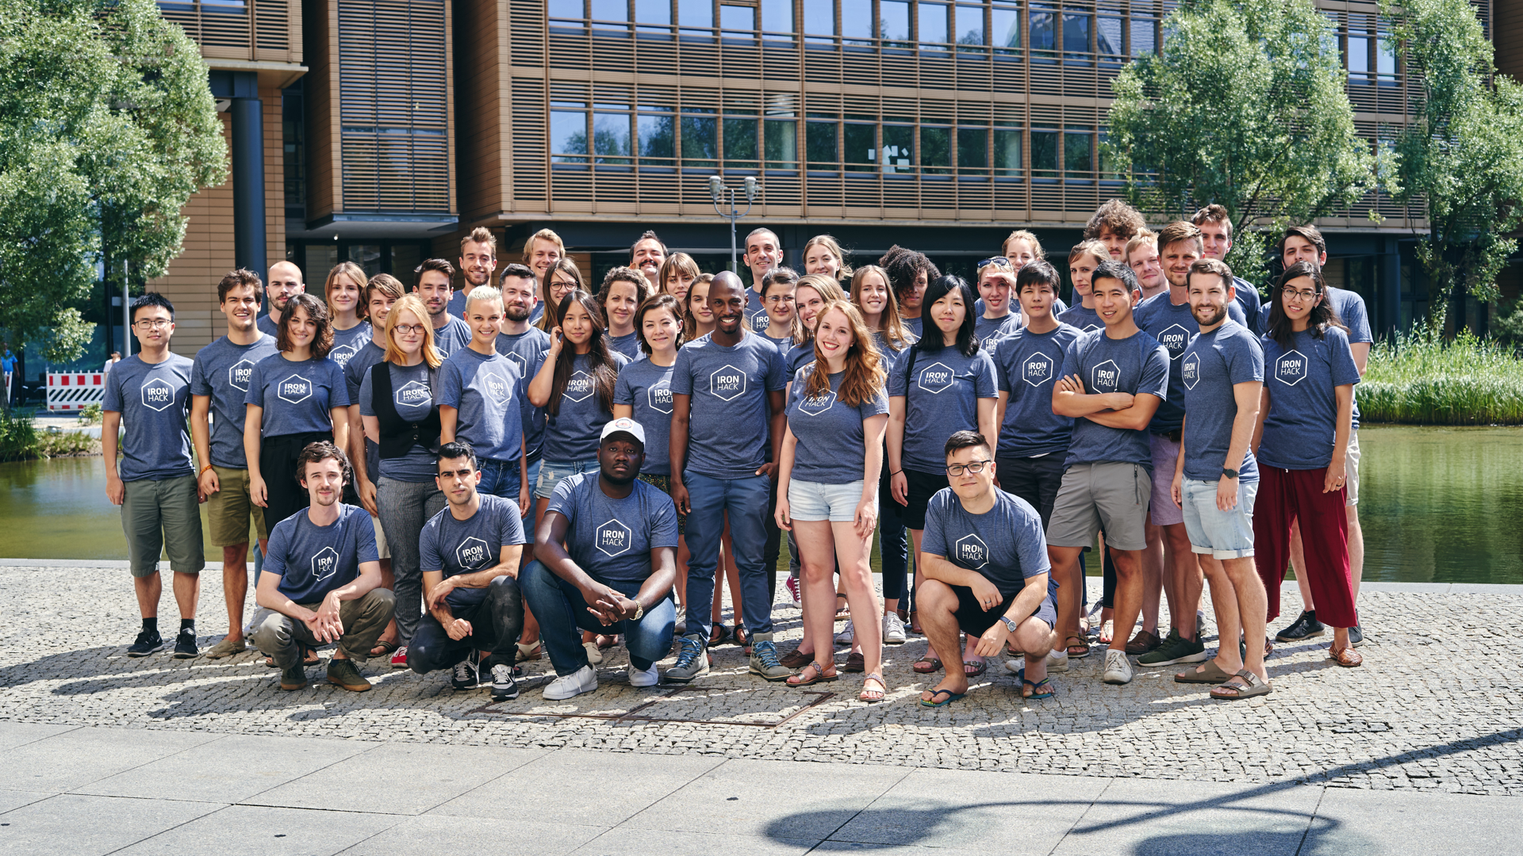

Using SQL to analyse customer behaviour

Slide 3

Bank Customer Analysis: What are we trying to find out?
Bank contains data about customer loans, repayments and status, as well as some customer demographics
Overall TASKs are:
Identify the good clients to whom we can offer other services
Identify the bad clients that have to watch carefully to minimize the losses
Can I use my data analysis toolkit to analyse customer behaviour and start identifying good/ bad customers? Can I identify any problems that the Bank has in general ?

Slide 4
How do banks make money?
1. Profits from debt interest - When you deposit your money in a bank account, the bank uses that money to make loans to other people and businesses to whom they charge interest.
2. Banking fees - Another way banks make money is through regular or case-by-case fees, such as account maintenance fees, withdrawal / transfer fees or unapproved overdraft fees.
3. Interchange fees While swiping your debit or credit card is generally free to you, a transaction or processing fee called interchange is typically generated. This fee is charged by your bank to the merchant's bank (merchant being the store where you made the purchase) as a percentage of your transaction.

Slide 5
How do banks LOSE money? (/bank failure)
A bank fails when it can’t meet its financial obligations to creditors and depositors. This could occur because the bank in question has become insolvent, or because it no longer has enough liquid assets to fulfill its payment obligations.
The most common cause of bank failure occurs when the value of the bank’s assets falls to below the market value of the bank’s liabilities, which are the bank's obligations to creditors and depositors. This might happen because the bank loses too much on its investments (eg negative equity on mortgages) or has a larger than expected amount of loan defaults, plus loans being written off which it cannot absorb

Slide 6
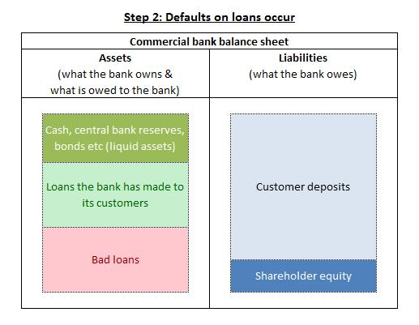
How do banks LOSE money? (/bank failure)
With our bank database we do not have records of deposits, only loans, so we cannot establish the balance sheet

Slide 7

Banking Key Driver - Account Holder Churn
Over time # accounts
Over time # transactions
Over time amount moved
Over time # loans
Classify clients as good or bad based on their loan status (simplified)
Add this classification to a time series analysis
Is the bank churning bad or good clients?

Slide 8
Bank Churn Analysis: problem and approach (1)
Problem # 1 = Customer Churn / attrition
Let’s find out month to month, how many accounts/trans we have which belong to ‘good’ or ‘bad’ clients
Tool = SQL aggregation with a WHERE filter
Approach - join Trans to Loans /Accounts (Disp) - using a subquery to flag bad/good customers based on Loan status (or create a view with a bad/good flag column)
Then, extract the data as a csv (or read into python) and visualise the time series in Tableau or Python

Slide 9
Bank Churn Analysis: problem and approach (2)
Problem # 1 = Customer Churn / attrition
Let’s find out month to month, how many unique account holders were making transactions, as an indicator of churn.
Tool = Window LAG function
Approach - create Views for re-usability/ease of coding
https://www.sqlservertutorial.net/sql-server-window-functions/sql-server-lag-function/

Slide 10

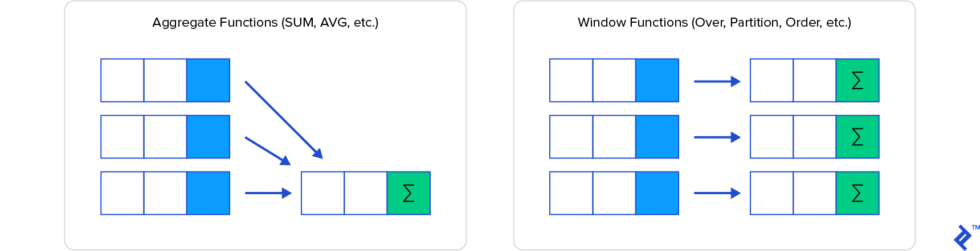
Review of Window functions

Slide 11
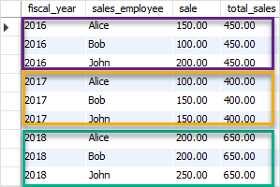
Review of Window functions
Select SUM(sale)
OVER (
Partition by fiscal_year)
As ‘total_sales’
From salestable

Slide 12
Review of Window functions
Window = “Partition” (PARTITION BY) + “Ordering” (ORDER BY) + “Frame” (ROW/RANGE)
OVER defines the set where the function will be applied
OVER (
PARTITION BY -> Divides the set in “chunks” where the function is applied independently (similar to GROUP BY)
ORDER BY -> How to sort the elements within the partition
ROW or RANGE -> Set “boundaries” within each “chunk”
) AS [alias]

Slide 13
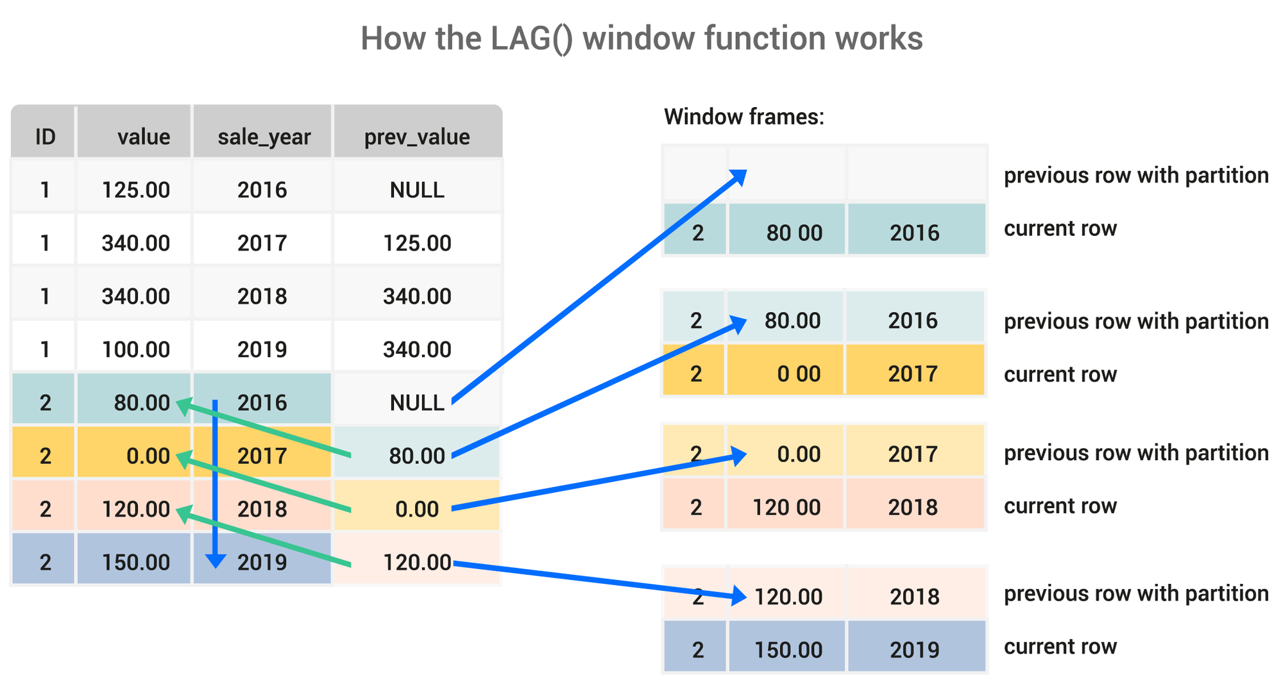
Window function in use - LAG

Slide 14
Bank Churn Analysis: problem and approach (3)
Problem # 1 = Customer Churn / attrition
Let’s find out how many customers keep doing their transactions at this bank in subsequent months- how many active accounts has the bank retained?
Tool = self join
Approach - create View/CTE for re-usability/ease of coding
https://www.sisense.com/blog/use-self-joins-to-calculate-your-retention-churn-and-reactivation-metrics

Slide 15
Bank Churn Analysis: problem and approach (3)
Table 2
Table 1
Count dist account_id | Activity Year | Activity Month
93 | 1993 | 01
183 | 1993 | 02
281 | 1993 | 03
Count dist account_id | Activity Year | Activity Month
93 | 1993 | 01
183 | 1993 | 02
281 | 1993 | 03
Calculate the Difference

Slide 16

Using Machine Learning to predict customer behaviour
Conceptual Example : predicting survivors of the Titanic data set
Real Life Example : Predicting loan status in the Bank database

Slide 17

IRONHACK BOOTCAMP
What data insights can we get from doing ML?
Which features have the greatest impact on the outcome?
Which features are irrelevant to the outcome?
Do we have any unexpected outcomes?
Can we change the marketing or product strategy to promote better health of the Bank lending book?
Are there some demographics or behavioural profiles for customers we wish to attract or deter ?

Slide 18
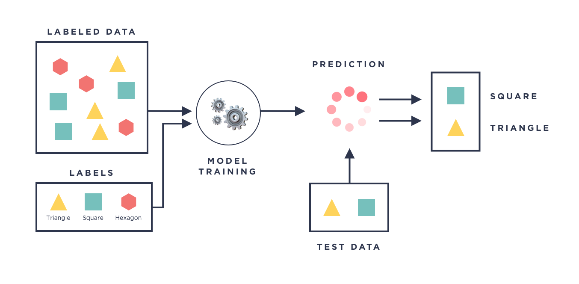
IRONHACK BOOTCAMP
SUPERVISED MACHINE LEARNING MODELS
Supervised machine learning models are all the model which needs to be trained based on examples:

Slide 19
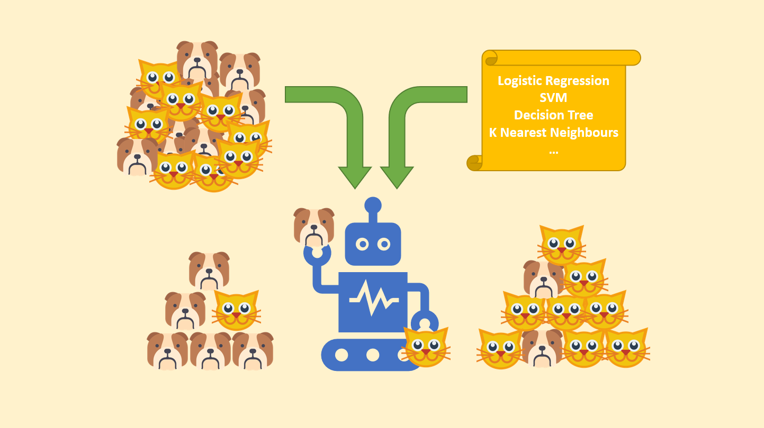
Logistic Regression - titanic data set

Slide 20
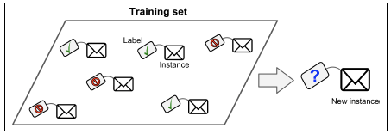
Logistic Regression - binary classification

Slide 21
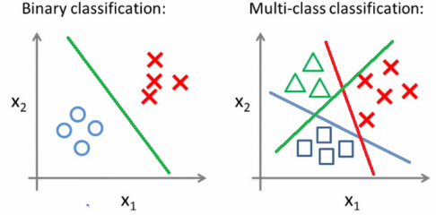
Logistic Regression - binary v multi class

Slide 22
Logistic Regression - binary v multi class
In our Bank scenario our binary ML problem is :
In our Bank scenario our multiclass ML problem is :

Slide 23
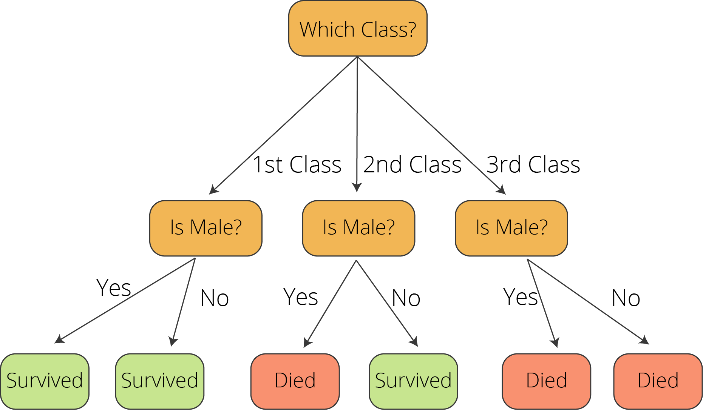
Logistic Regression - conceptual example

Slide 24
What is logistic regression?
Logistic regression is a technique for modelling the probability of an event.
Just like linear regression, it helps you understand the relationship between one or more variables and a target variable
Except that our target variable is binary: its value is either 0 or 1.
Example:
It’s possible to say that “smoking can increase your risk of having lung cancer by 20%”, since having lung cancer is a binary variable: you either have it or not.
From that, we can infer classification probability based on other factors
like whether someone will have lung cancer given that he/she does not smoke, lives in a polluted city and has a family history of lung cancer.

Slide 25
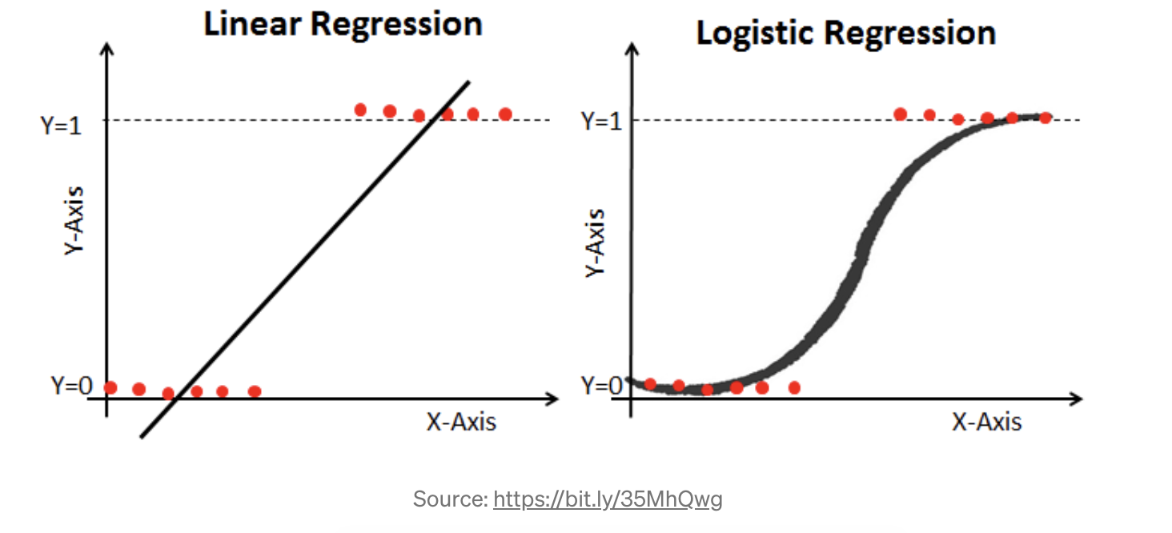
Understanding logistic regression
To better understand the difference between a linear and a logistic regression, imagine we plotted the lung cancer variable in the Y-axis (Y = 1 if patient has lung cancer and 0 otherwise) and the patient’s age in the X-axis.
Here we have the resulting lines from each regression. Which one seems more fit to our data?

Slide 26
When to use logistic regression?
When linear regression makes no sense for our data - eg if we follow a line the linear approach would take us > 100%
Logistic ensures a curve cannot exceed 100% or go below 0
Where response variable is a proportion
When we want a model to predict probabilities of different possible outcomes of a categorically distributed response variable, given a set of independent variables
*NB dont confuse with logarithmic scale

Slide 27




IRONHACK BOOTCAMP
NO FREE-LUNCH THEOREM
Every model makes assumptions about data. If those assumptions are not met, the model is doomed to fail.
Model assumptions determine the pre-processing steps required.
Preprocessing
Preprocessing
Model
Model

Slide 28
IRONHACK BOOTCAMP
LOGISTIC MODEL (for binary classification)
The logistic model makes the following assumptions:
DOES NOT require a linear relationship between the dependent and independent variables.
The error terms (residuals) DO NOT need to be normally distributed.
Independent observations (not repeated).
Multicollinearity NOT RELEVANT.
Dependent variable MUST be categorical and can only have two possible values. (yes/no, 1/o, True/False).
Larger dataset, at least 10 cases for each possible target value.

Slide 29
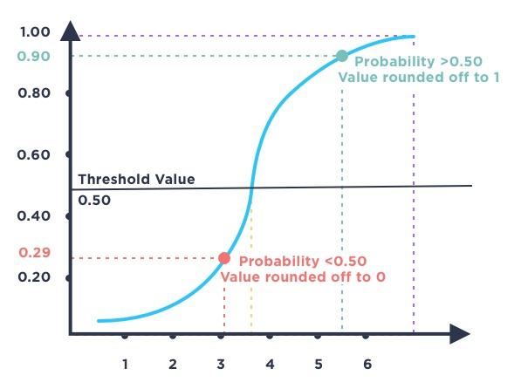
IRONHACK BOOTCAMP
DETERMINING THE PREDICTION OF THE LOGISTIC MODEL

Slide 30
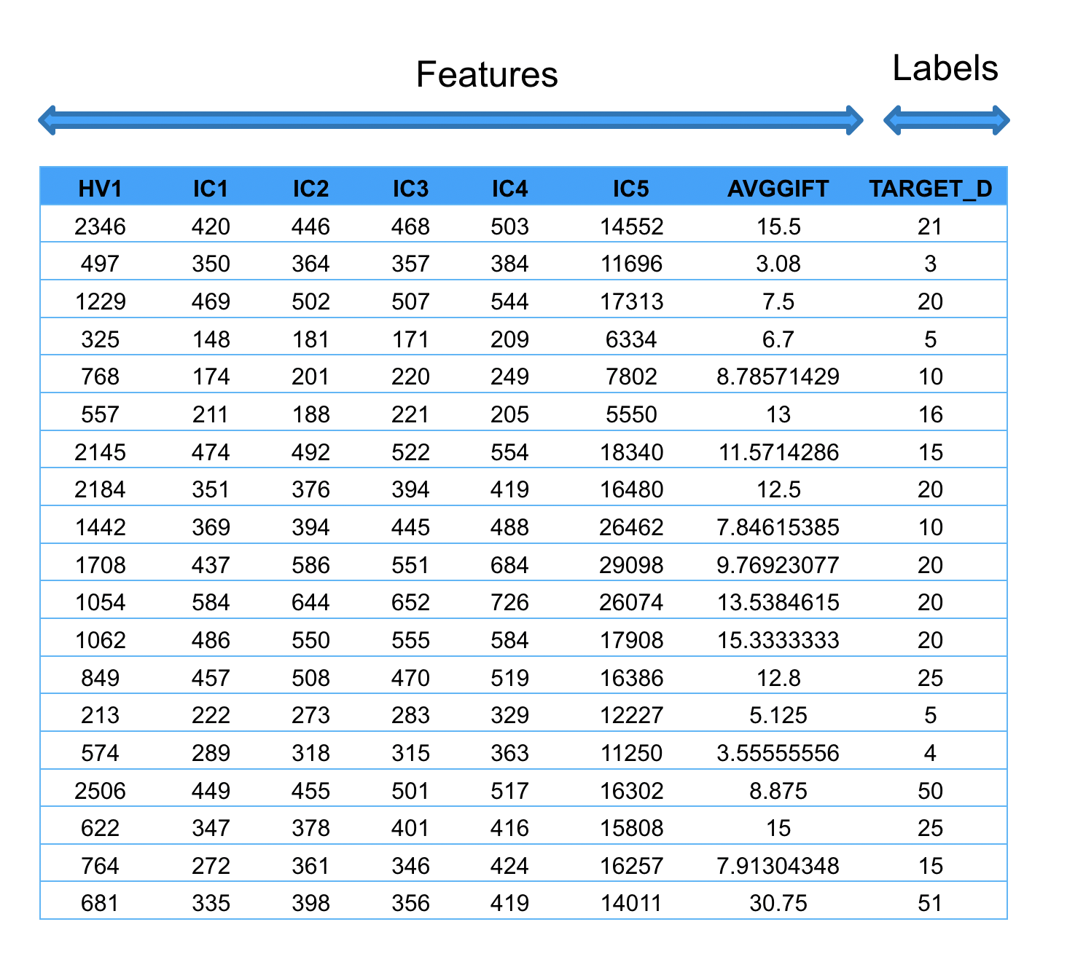
IRONHACK BOOTCAMP
IRONHACK BOOTCAMP
Terminology
Regression Problem:
Predicting an amount
Target_D is the dependent variable.
The features are the independent variables.

Slide 31
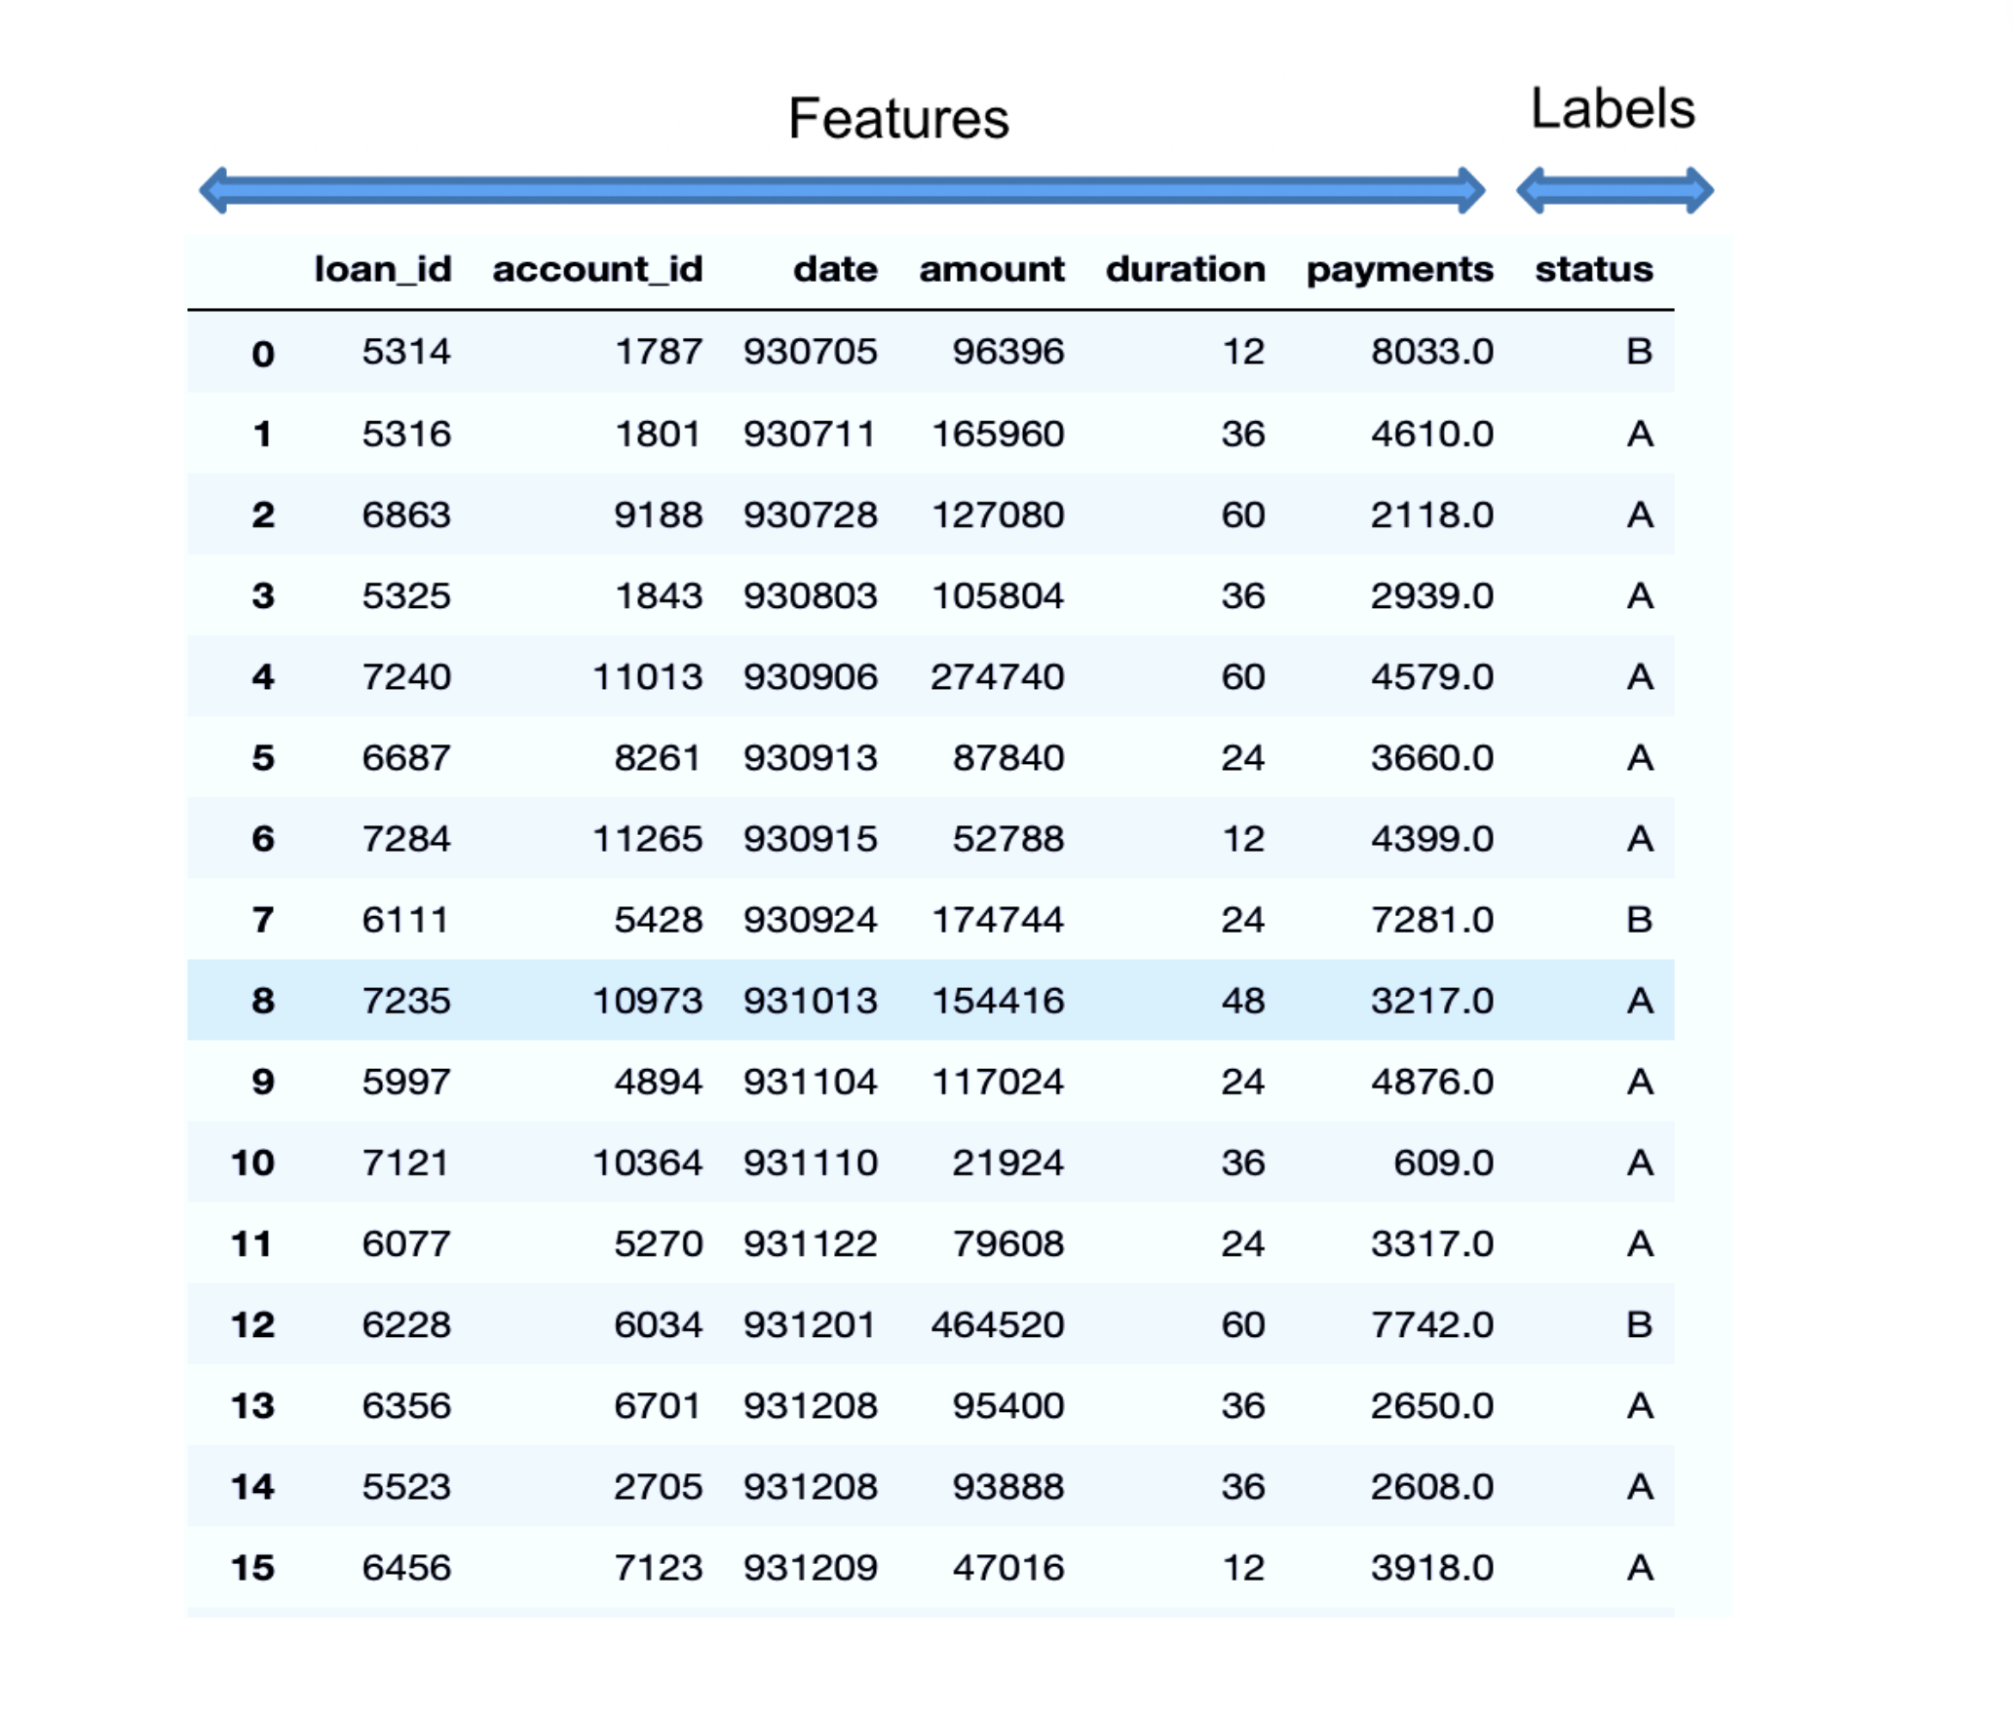
IRONHACK BOOTCAMP
IRONHACK BOOTCAMP
IRONHACK BOOTCAMP
Terminology
Classification Problem:
Predicting target variable that are labels
... in this case a binary (A or B, True or False, Yes or No, 1 or 0)

Slide 32
A credit card company receives thousands of applications for new cards. Each application contains information about an applicant:
●Age
●Marital status
●Annual salary
●Outstanding debts
●Credit rating
Others
Typical
Classification Problem
ML Problem:
Decide whether an applicant should be approved.
Classify applications into two categories: approved, and not-approved

Slide 33
Bank Customer Analysis: What are we trying to find out?
Problem # 2 = a proactive approach to bad/good customers based on their loan status
Can we predict the status of a loan based on the data from the loan and trans table?
Approach - develop a simple ML classification model to predict the status of the loan.
Tool = logistic regression

Slide 34
Types of classification problems

Slide 35

IRONHACK BOOTCAMP
WHAT DO WE WANT TO PREDICT?
We want to predict the “STATUS”
of a bank customer
If we were going for binary classification:
Can we predict A or B status ?
Multi class classification:
Which status will it be, A,B,C or D?

Slide 36
IRONHACK BOOTCAMP
Stage 1 - IMPORTING SQL DATA INTO PYTHON
We can do a left join to bring in all trans and loans they are linked to
Ignoring any Id columns, renaming columns as appropriate
query = '''select t.type, t.operation, t.amount as t_amount, t.balance, t.k_symbol, l.amount as l_amount, l.duration, l.payments, l.status from trans t
left join loan l
on t.account_id = l.account_id
where l.status in ('A', 'B');'''
data = pd.read_sql_query(query, engine)
data.head()

Slide 37
Next stages
Create a data frame in pandas/python
Use EDA methods to explore the data
Identify any needed clean steps
What pre-processing needed for this model?
T-T split and Run the model

Slide 38
4. Pre-processing
Q: are the data types correct? Do we need to encode categorical data? Are there any numeric data types which could be treated as categorical data
T: Check for multicollinearity (not necessarily a concern for logistic regression!)
Q: Are the features skewed? If yes, normalise/scale
NOTE - for logistic regression, skewness in independent variable is not a problem as is with linear regression. But transformation may help the model fit /run

Slide 39
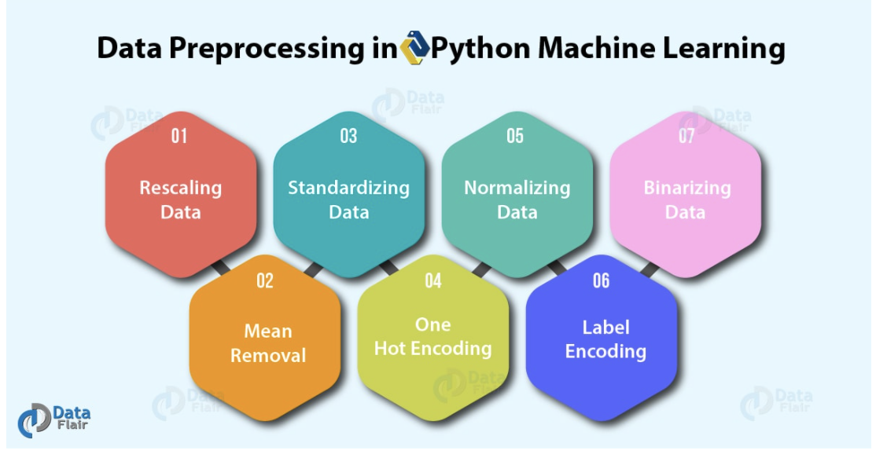
4. Pre-processing

Slide 40
5. Train Test split and Run the model
Test size 40%
Import logistic regression
Classification score

Slide 41
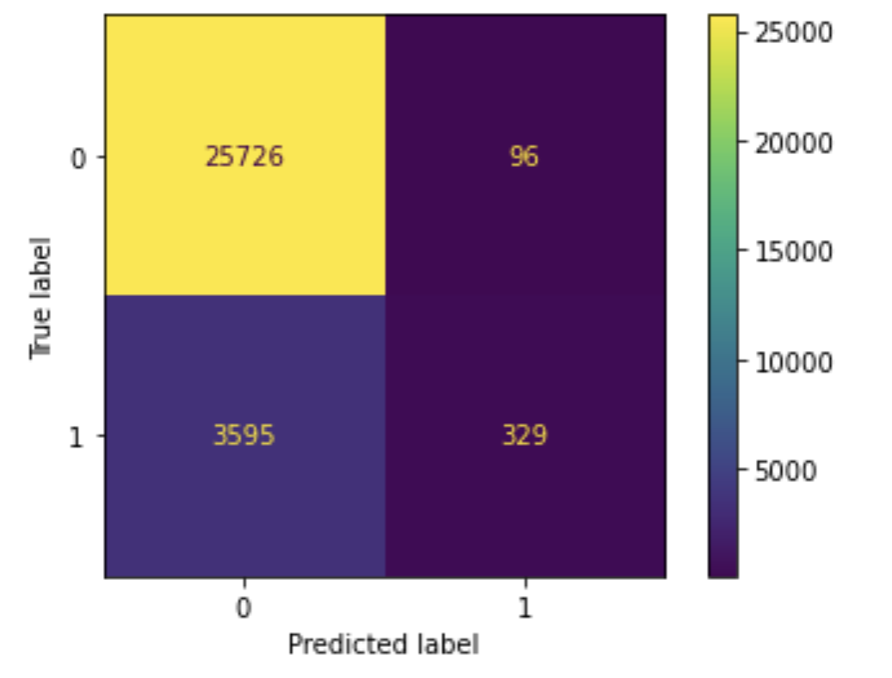
Next stages
6. Evaluation of the model - accuracy, confusion matrix
7. Consider if the model is overfit

Slide 42
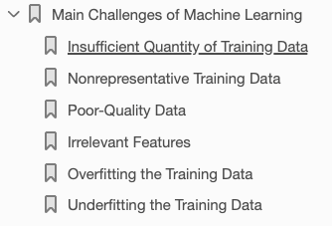
IRONHACK BOOTCAMP

Slide 43
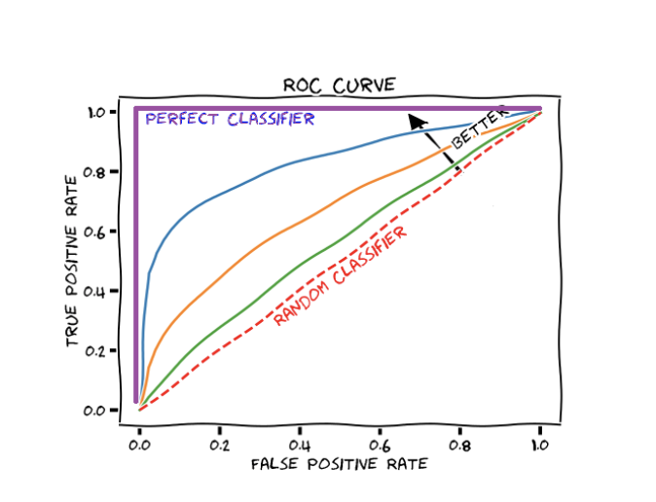
IRONHACK BOOTCAMP
IRONHACK BOOTCAMP
Stage 6 - how can we evaluate a model?
The ROC curve is a method to compare different settings for your model (threshold).
It answer the question of: “What is the best threshold to use?”
Each dot of the curve corresponds to a different value of the threshold
= Recall
= 1-(FP/(FN+TN)
Notes:
https://towardsdatascience.com/logistic-regression-the-basics-b1716661c71b

Slide 44
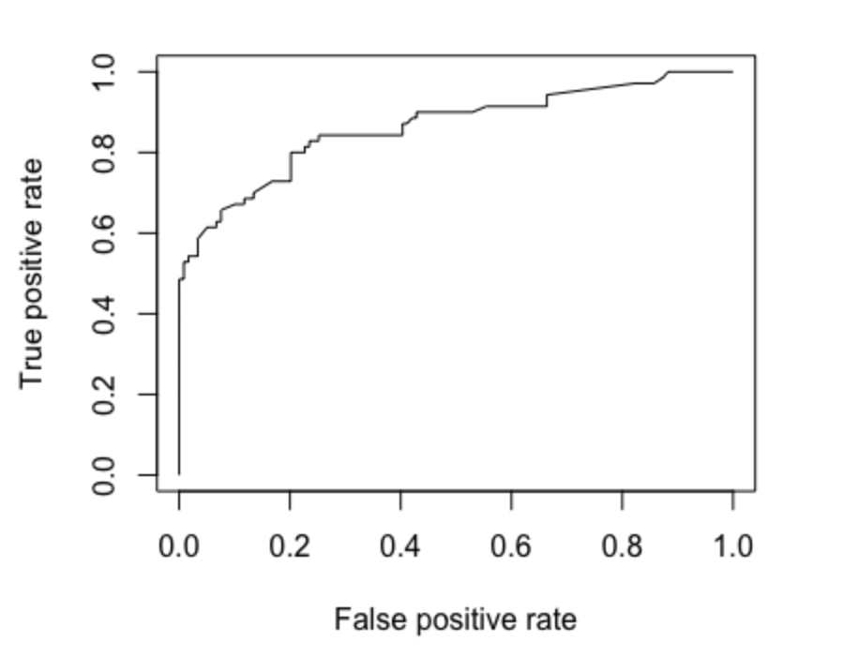
IRONHACK BOOTCAMP
Stage 6 - how can we know a model is useful?
Accuracy = x- is this good ? how many would we have got correct with guesswork?
ROC (receiver operating characteristic)- plots true positives against false positives
Plot the curve - bigger the AUC (area under the curve) the better the model
We want a curve as close to top left as possible
Notes:
https://towardsdatascience.com/logistic-regression-the-basics-b1716661c71b

Slide 45
IRONHACK BOOTCAMP
IRONHACK BOOTCAMP
IRONHACK BOOTCAMP
Stage 6 - how can we evaluate a model?
GETTING THE ROC FROM SKLEARN
from sklearn import metrics
import matplotlib.pyplot as plt
y_pred_proba = classification.predict_proba(X_test)[::,1]
fpr, tpr, _ = metrics.roc_curve(y_test, y_pred_proba)
auc = metrics.roc_auc_score(y_test, y_pred_proba)
plt.plot(fpr,tpr)
Notes:
https://towardsdatascience.com/logistic-regression-the-basics-b1716661c71b

Slide 46
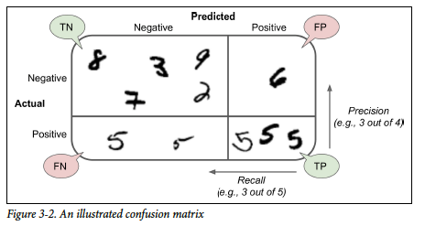
Confusion matrix - imagine we want to predict if a handwritten digit is a 5 (or not). If our model is good, it will often be right.

Slide 47
IRONHACK BOOTCAMP
IRONHACK BOOTCAMP
IRONHACK BOOTCAMP
Stage 6 - how can we evaluate a model?
GETTING THE CONFUSION MATRIX FROM SKLEARN
>>> from sklearn.metrics import confusion_matrix
>>> y_true = [2, 0, 2, 2, 0, 1]
>>> y_pred = [0, 0, 2, 2, 0, 2]
>>> confusion_matrix(y_true, y_pred)
array([[2, 0, 0],
[0, 0, 1],
[1, 0, 2]])
Notes:
https://towardsdatascience.com/logistic-regression-the-basics-b1716661c71b

Slide 48
IRONHACK BOOTCAMP
IRONHACK BOOTCAMP
IRONHACK BOOTCAMP
Stage 6 - how can we evaluate a model?
GETTING THE CONFUSION MATRIX FROM SKLEARN
>>> from sklearn.metrics import confusion_matrix
>>> y_true = ["cat", "ant", "cat", "cat", "ant", "bird"]
>>> y_pred = ["ant", "ant", "cat", "cat", "ant", "cat"]
>>> confusion_matrix(y_true, y_pred, labels=["ant", "bird", "cat"])
array([[2, 0, 0],
[0, 0, 1],
[1, 0, 2]])
Notes:
https://towardsdatascience.com/logistic-regression-the-basics-b1716661c71b

Slide 49
IRONHACK BOOTCAMP
CONFUSED? USE THE CONFUSION MATRIX!
Real
Positive
Negative
Positive
TP
FP
Predicted
Negative
FN
TN
Notes:
https://www.kaggle.com/utah12005/titanic-guided-by-a-confusion-matrix

Slide 50

IRONHACK BOOTCAMP
CONFUSED? USE THE CONFUSION MATRIX!
Real
Positive
Negative
If you are deemed to fail what kind of error do you prefer to make?
Positive
TP
FP
Type I error
Predicted
Negative
FN
TN
Type II error

Slide 51



IRONHACK BOOTCAMP
CONFUSED? USE THE CONFUSION MATRIX!
Real
Positive
Negative
Positive
TP
FP
Type I error
Predicted
Negative
FN
TN
Type II error

Slide 52

IRONHACK BOOTCAMP
CONFUSED? USE THE CONFUSION MATRIX!
Real
Positive
Negative
Positive
TP
FP
Type I error
Predicted
Negative
FN
TN
Type II error

Slide 53
IRONHACK BOOTCAMP
CONFUSED? USE THE CONFUSION MATRIX!
Real
Positive
Negative
Accuracy = (TP+TN)/(TP+TN+FP+FN)
Positive
TP
FP
Precision = (TP)/(TP+FP)
Type I error
Recall = (TP)/(TP+FN)
Predicted
F1 = 2 *(Precision*Recall)/(Precision + Recall)
Negative
FN
TN
Type II error

Slide 54
Can we improve the confusion matrix?

Slide 55
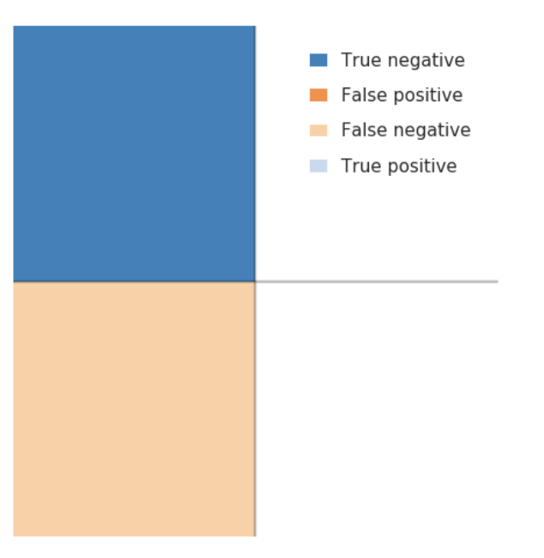
IRONHACK BOOTCAMP
Conceptual example - Confusion Matrix with Titanic data
Lets assert everyone died
Classic example of a NULL hypothesis
Accuracy = 0.61 (errors 0 39%)
Reducible error - add some variables / generalisations into our model to iterate towards better accuracy.
Irreducible error - survival based on chance - people jumped into the water to save relatives, jumped into lifeboats while they were being lowered, or jumped into the water.

Slide 56
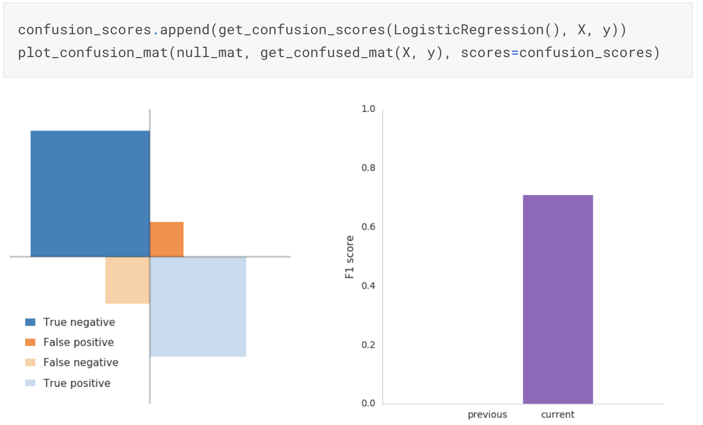
IRONHACK BOOTCAMP
Confusion Matrix with Titanic data- generalisation A
“women and children first” … lets assert all women survived
Notes:
Note from spiegalhalter book - high accuracy of this simple rule - though naive - is just behind some more complex algorithms. Demonstrates the inadequcy of crude accuracy as a measure of performance. Random forest - best discrimination under ROC curve, probabilities from simple classication tree have the best brier score - no clear winner . table write up whiteboard

Slide 57
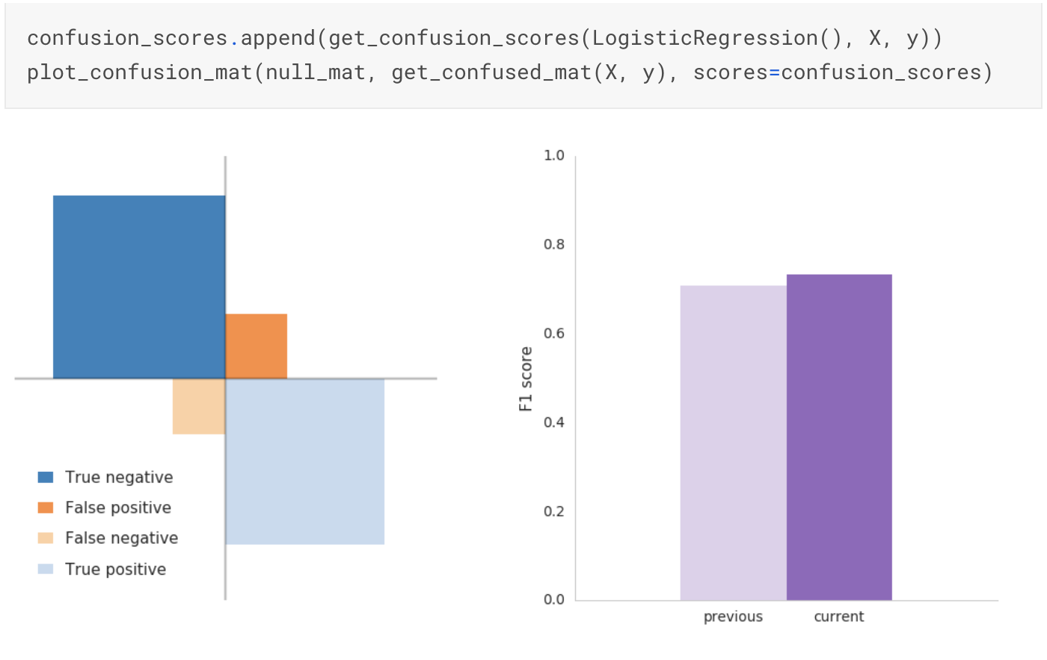
IRONHACK BOOTCAMP
Confusion Matrix with Titanic data- generalisation B
“women and children first” … split the children out
Notes:
Our score slightly improved but not as much as we may have anticipated. By accounting for children, we regained 23 male children misclassified as victims. These passengers were transferred from false negatives to true positives.
At the same time, our improvements were offset by an increase in false positives. Not all children survived. To account for this increase, we need to add dimension to our model

Slide 58
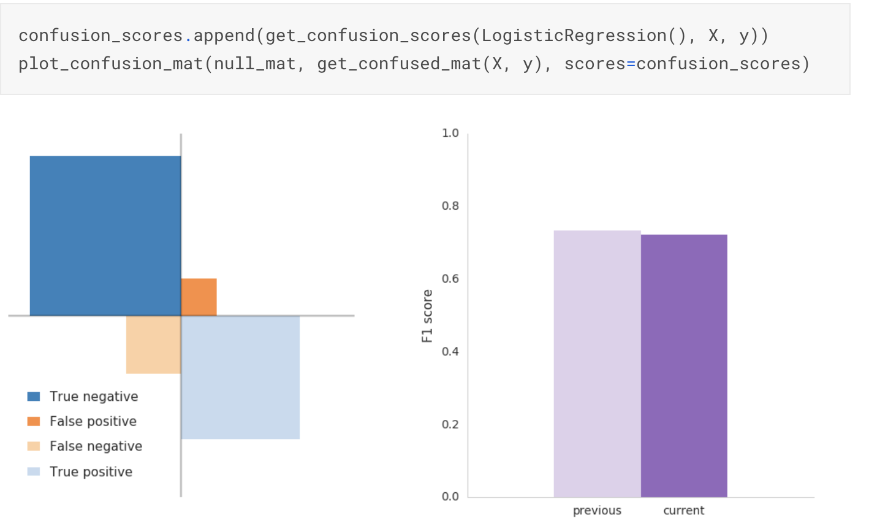
IRONHACK BOOTCAMP
Confusion Matrix with Titanic data- generalisation C
Class matters … split the passengers by class
Notes:
Our score improved again. Given the low survival rate in class 3, we increased our true negatives and reduced our false positives. We're now accounting for women and children who died in class 3. However, our false negatives are back up again. And our F1 decreased. Contrary to our model's assertion, not all class 3 passengers died.Can we find something in our data to account for surviving class 3 passengers?It's tricky.First, surviving class 3 passengers were very lucky. All other passengers had more time, more access and less people to compete with for a seat in the lifeboats. We can't generalize what's largely attributable to chance.Second, whatever feature we identify to account for surviving class 3 passengers needs to apply to class 1 and 2 passengers as well. If not, we'll trade false negatives between features.We need a featured shared by all passengers to more accurately account for passengers in class 3

Slide 59
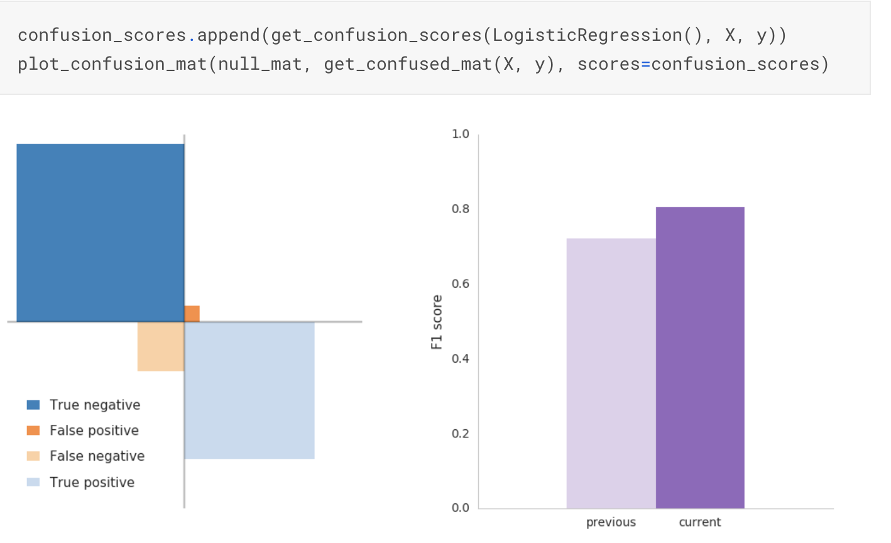
IRONHACK BOOTCAMP
Confusion matrix… perishing mothers/wives
No of siblings/spouses, parents/children is an influence on survival
Notes:
Had to create a feature called family based on surname etc , By accounting for perishing mothers/wives, we greatly improved our accuracy and reduced our false positives. It makes sense our model reduces false positives since we're making connections between people who likely died. The trade off between false positive and true negative is likely male children traveling in class 3 who we misclassified as survivors.

Slide 60

IRONHACK BOOTCAMP
Confusion matrix… surviving_father_husband
No of siblings/spouses, parents/children is an influence on survival
Notes:
By connecting male survivors (surviving_father_husband) with their families, we reduced our false negatives. The trade off between false negative and true positives is likely the male adults and male children in class 3 we misclassified as victims.

Slide 61
Next stages
6. Evaluation of the model - accuracy, confusion matrix
7. Consider if the model is overfit

Slide 62

IRONHACK BOOTCAMP
IRONHACK BOOTCAMP
Stage 7 - overfitting (it happens…)

Slide 63
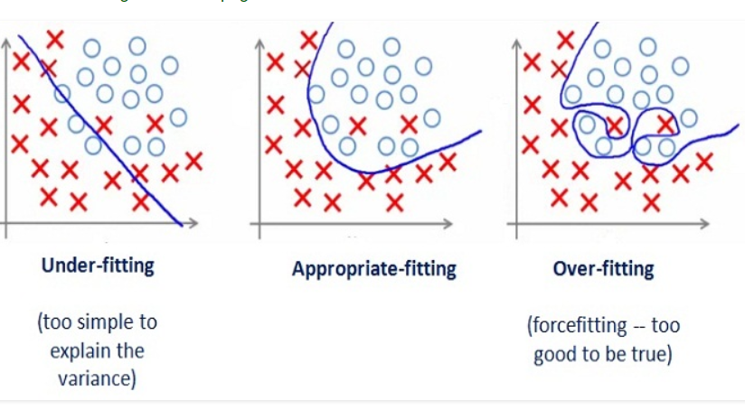
IRONHACK BOOTCAMP
IRONHACK BOOTCAMP
Stage 7 - overfitting (it happens…)

Slide 64
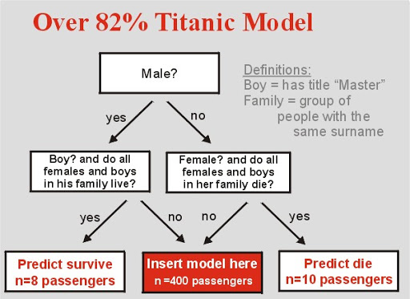
IRONHACK BOOTCAMP
Output Titanic data - overfitting?
High risk of overfitting when using surnames from the training set to link family members.

Slide 65
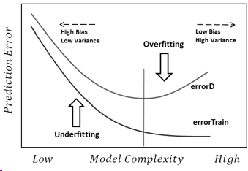
IRONHACK BOOTCAMP
Bias to overfit

Slide 66
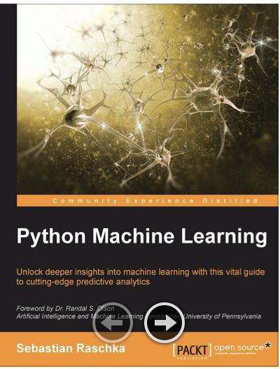
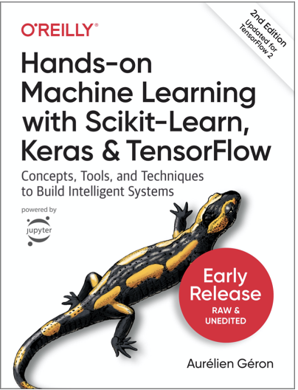
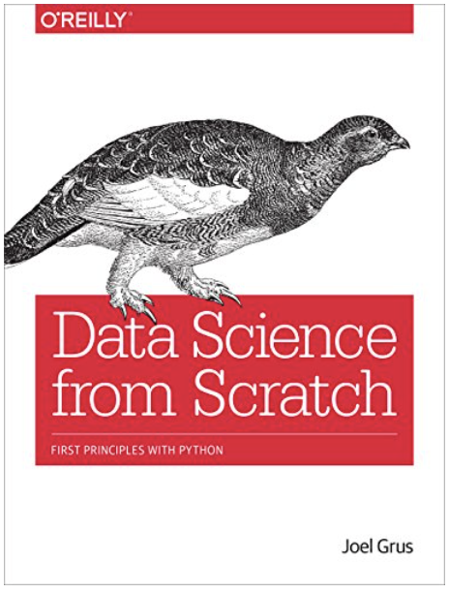
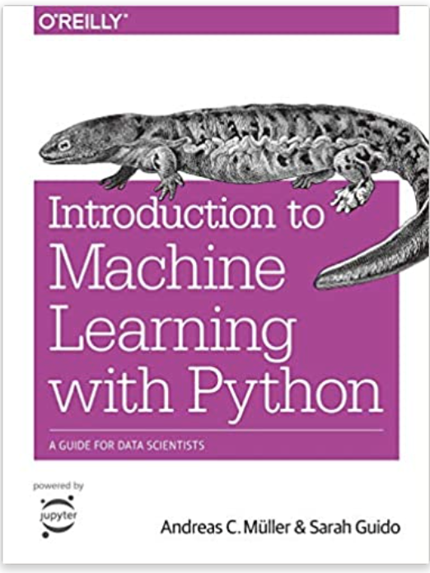
IRONHACK BOOTCAMP
Some self paced resources on ML
What is Machine Learning?, Google Cloud Platform (5:22 min) -
https://www.youtube.com/watch?v=HcqpanDadyQ
- Intro to Machine Learning (ML Zero to Hero - Part 1), Tensorflow (7:17 min) -
https://www.youtube.com/watch?v=KNAWp2S3w94
- A Gentle Introduction to Machine Learning, StatQuest (12:44 min) -
https://www.youtube.com/watch?v=Gv9_4yMHFhI&t=0s
Reading list :

